Slide 1
UC Expansion of Paid Sick Leave Training for Academic Personnel, Human Resources, and UCPath Staff
Systemwide Academic Personnel
Systemwide HR Policy
Systemwide Labor Relations
UC Legal
UC Path
Current as of October 10, 2024

Slide 2
Overview
I. Introduction
II. Policy-Covered Staff and Academic Appointees
Expansion of Eligibility for Paid Sick Leave
Expansion of Reasons to Use Paid Sick Leave
Protected Paid Sick Leave
Notice and Documentation Requirements
Extension of Paid Sick Leave Reinstatement Timeframe
III. Represented Staff and Academic Appointees
IV. UCPath Update
V. Q&A Sessions

Slide 3
Introduction Policies and Collective Bargaining Agreements
UC intends to expand paid leave options for sick leave purposes across the UC workforce.
The policies that cover non-represented staff are Personnel Policies for Staff Members (PPSM). Non-represented academic appointee policies are found in the Academic Personnel Manual (APM).
Expanded paid sick leave edits to PPSM-2.210 (Absence from Work) and APM - 710 (Leaves of Absence/Paid Sick Leave/Paid Medical Leave) were issued on May 31, 2024.
Changes to these policies are effective January 1, 2025.
Collective bargaining agreements (CBAs) cover union-represented staff employees and academic appointees.
Systemwide Labor Relations is working with bargaining unit representatives to incorporate an expansion of paid leave options for sick leave purposes, subject to collective bargaining requirements, for represented employees.
Systemwide Labor Relations will continue to update locations regarding the status of these efforts.

Slide 4
Introduction Resources
Expanded Sick Leave Box Site
Location training information and resources are available on the UC Expanded Paid Sick Leave – Location Implementation Resources Box site.
Employee Communications
An employee-focused UCnet website and employee FAQs regarding the paid sick leave expansion will be available in late October.
Locations are responsible for communicating location-specific information to employees, such as time and attendance system changes required to enable employees to designate whether they are recording protected paid sick leave or paid sick leave.
Contact: ExpandedSickLeave@ucop.edu

Slide 5
Policy-Covered Staff
and Academic Appointees

Slide 6
Expansion of Eligibility for Paid Sick Leave (APM and PPSM) Paid Sick Leave Accrual for Appointments Below 50%
Current Status
Staff employees accrue paid sick leave if they are on pay status at least one-half of the working hours of a month or quadriweekly cycle in which it is earned. Academic appointees in sick-leave accruing titles accrue paid sick leave if they have an appointment percentage of 50% or more.
Effective 1/1/2025
Staff employees will begin accruing paid sick leave at a rate proportionate to their hours on pay status. Academic appointees in sick-leave accruing titles will begin accruing paid sick leave at a rate proportionate to their percentage of appointment. For example, an employee who works 25% time will accrue about 2 hours of paid sick leave per month.
NOTE: There are some titles, such as faculty and per diem staff, that do not currently accrue paid sick leave. Their titles will not accrue paid sick leave under these policy changes, but they will be offered other paid sick leave options that we will cover in this training.

Slide 7
Expansion of Eligibility for Paid Sick Leave (APM) Academic Appointee Paid Sick Leave Bank
Current Status
The following academic appointees do not accrue paid sick leave: faculty members (as defined in APM - 110-4-(15)), including those who are participants in the Health Sciences Compensation Plan (HSCP), as well as Agronomists, Astronomers, Curators, and “by agreement” appointees in university extension pursuant to APM - 600 – Appendix 9.
Effective 1/1/2025
All eligible faculty, as well as Agronomists, Astronomers, Curators, and “by agreement” appointees in university extension pursuant to APM - 600 – Appendix 9, with a paid appointment of at least thirty calendar days in a calendar year will receive a bank of six days per calendar year that can be used for the same purposes as accrued paid sick leave.
Part-time faculty will receive the same number of days and will be paid at the percentage of appointment they have at the time the leave is taken.
A new bank of six (6) days of paid sick leave will subsequently be available on January 1 of each following year. The bank of unused paid sick leave days will expire on each December 31 or the last date of appointment if the appointment ends before December 31.

Slide 8
Expansion of Eligibility for Paid Sick Leave (PPSM) Paid Sick Leave for Per Diem Staff
Current Status
Staff in Per Diem appointments are not currently eligible to accrue or use paid sick leave.
Effective 1/1/2025
Per Diem employees will receive 8 hours of paid SL per calendar year. The new allotment is provided each January 1. They may carry over unused paid sick leave from the previous year, but have a maximum of 16 hours at any time. They may use up to 16 hours of paid SL in a calendar year.
For new Per Diem hires, the paid sick leave will be credited and available for use on the next working day following the employee’s first monthly or quadriweekly pay cycle.
Example: A Per Diem employee starts on May 1, 2025. The employee receives 8 hours of SL for 2025 and uses 4 hours. On January 1, 2026, the employee receives another 8 hours of SL. They carry over 4 hours from 2025 and have a balance of 12 hours available for use in calendar year 2026.

Slide 9
Expansion of Eligibility for Paid Sick Leave (PPSM) PTO Staff
Current Status
PTO programs and attendance policies are developed and managed by locations.
Effective 1/1/2025
PTO programs must meet the minimum paid sick leave requirements described in Section III.C (Sick Leave) of PPSM-2.210 (Absence from Work).
SHR Policy is working with locations to update their PTO program documents.

Slide 10
Protected Paid Sick Leave (APM and PPSM)
Current Status
Paid sick leave is not “protected” on its own, but other protections are available in specific circumstances. For example, an eligible employee may use paid sick leave while the employee is taking protected leave for their own serious health condition under the Family and Medical Leave Act.
Effective 1/1/2025
Protected paid sick leave will be available.
All of an eligible Per Diem employee’s paid sick leave and up to 6 days per calendar year of any other eligible employee’s paid sick leave may be used as protected paid sick leave if the employee uses the leave for the purposes specified in policy and complies with applicable notice requirements.

Slide 11
Protected Paid Sick Leave (APM and PPSM) Use of Protected Paid Sick Leave
Paid sick leave may be used for a number of purposes, not all of which are protected.
For example, an employee may use paid sick leave for a household member who is not a family member as described in policy, but may not use protected paid sick leave in these circumstances.
An eligible employee may use protected paid sick leave for:
Diagnosis, care, or treatment of an existing physical or mental health condition of the employee or the employee’s family member;
Preventive care for the employee or the employee’s family member; and
Those reasons specified in policy for an employee who is a victim or whose family member is a victim of domestic violence, sexual assault, stalking, or other crimes. [NOTE: Additional revisions to policy will be made for these purposes in light of recent legislation.]
Refer to policy for definitions of covered family members, which include designated persons.

Slide 12
Protected Paid Sick Leave (APM and PPSM) Protections Afforded by Protected Paid Sick Leave
UC prohibits any form of retaliation or discrimination against an employee for:
Using or attempting to use protected paid sick leave;
Making a complaint or alleging a violation of the protected paid sick leave provisions in APM - 710 or PPSM-2.210;
Cooperating in an investigation regarding an alleged violation of the protected paid sick leave provisions in APM - 710 or PPSM-2.210; or
Opposing any policy, practice, or act that is prohibited by the protected paid sick leave provisions of APM - 710 or PPSM-2.210.

Slide 13
Notice and Documentation Requirements (APM and PPSM)
Current Status
Before using paid sick leave, PPSM-covered employees may be required to provide at least 30 days’ advance notice of foreseeable medical needs or as soon as possible and submit satisfactory proof of the inability to work, illness in the family, or bereavement.
Notice and documentation practices for APM-covered academic appointees are location-specific.
Effective 1/1/2025
Policy-covered employees may be required to:
Provide reasonable advance notice if the need for paid sick leave is foreseeable or provide notice as soon as practicable if the need for paid sick leave is unforeseeable;
Indicate when providing notice whether the employee is designating the paid sick leave as protected; and
Submit documentation supporting the need for paid sick leave when appropriate.

Slide 14
Notice and Documentation Requirements (APM and PPSM)
Documentation
Protected paid sick leave: UC generally will not require documentation when an employee requests to use protected paid sick leave consistent with policy, but there may be times when it is appropriate to request documentation. For example, UC may request documentation before paying protected paid sick leave when UC has information indicating that the employee is not requesting the leave for a valid purpose.
Paid sick leave: When an employee requests to use paid sick leave that is not protected, the employee must provide documentation consistent with local procedures.

Slide 15
Extension of Paid Sick Leave Reinstatement Timeframe (APM and PPSM)
Current Status
Policy-covered staff employees:
For a separation of less than 90 calendar days, all unused paid sick leave from prior service is reinstated.
For a separation between 90 and 180 days, up to 80 hours of accrued paid sick leave is reinstated.
For a separation of 180 days or more, paid sick leave is not reinstated.
Following a layoff, an employee will have all accrued sick leave reinstated if reemployed during the period of recall and preferential rehire (three years).
Policy-covered academic appointees:
For a separation of less than 15 calendar days, all unused paid sick leave from prior service is reinstated.
For a separation greater than 15 but less than 6 months, no more than 80 hours of accrued paid sick leave is reinstated.
For a separation of 180 days or more, paid sick leave is not reinstated.
Following a layoff, an appointee will have all accrued sick leave reinstated if reemployed within one year.
Effective 1/1/2025
For a separation up to 12 months, all unused paid sick leave is reinstated.
If a separation is more than 12 months, paid sick leave is not reinstated.
An appointee who is reemployed in the same calendar year in which they previously received a paid sick leave bank, shall have unused days from their previous paid sick leave bank reinstated.
Consistent with current policy, no paid sick leave is reinstated if the paid sick leave balance was previously converted to UCRP service credit upon retirement.

Slide 16
Represented Staff and
Academic Appointees

Slide 17
Collective Bargaining Agreements
UC intends to expand paid leave options for sick leave purposes for represented staff employees and academic appointees, subject to applicable collective bargaining requirements. Systemwide Labor Relations is working with bargaining unit representatives to provide this expansion.
Systemwide Labor Relations has offered some unions side letters and has passed proposals to others. Please contact Systemwide Labor Relations for questions about the latest status.
As agreements are reached, those agreements will be distributed by Systemwide Labor Relations and training materials will be updated accordingly.

Slide 18
UCPath

Slide 19
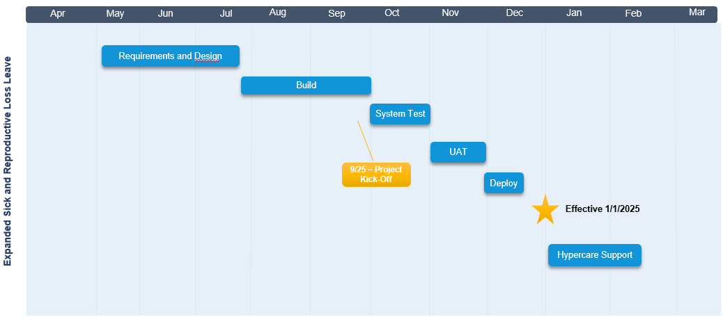
UCPath Training and Communication
Project Check In Meetings
COI and OCM Forums
Standalone Communications
Training analysis is currently in progress leveraging outputs from build and test phases. Updates will be provided to location project and training teams as they become available.
Biweekly implementation will begin with the first full pay period after the policy goes into effect on 1/1 (1/5/25 start date).

Slide 20
UCPath Training
The following is a preliminary list of UCPath training materials that will be updated:
Employee Self Service Users
Job Aid: How UCPath Displays Leave Balances
Simulation: Review My Leave Balances
Simulation: Review My Leave Balances (With Sabbatical Credit)
Location Users
Job Aid: UCPath Reports
Job Aid: Extended Absence Request Leaves and Description
Simulation: View Employee Absence Balance Data
Simulation: Submit Medical Leave of Absence Request
A full training schedule and additional deliverables are forthcoming.

Slide 21
Q&A Sessions

Slide 22
Q&A Sessions
Wednesday, October 23, 2024
10:00-11:00 am
Registration Link
Wednesday, November 6, 2024
10:00 am-11:00 am
Registration Link
Tuesday, November 19, 2024
11:00 am-12:00 pm
Registration Link
Please submit questions when you register or e-mail them to ExpandedSickLeave@ucop.edu.
Questions should be submitted at least three days in advance of the Q&A session you plan to attend.

